Slide 1

PRACTICAL APPLICATION #1
Annissa hovermill

Slide 2
project Requirements
GOAL:
Apply visualizations and probability distributions presented in this course to distinguish between customers who accepted a driving coupon. Explore the data using knowledge gained from plotting, statistical summaries, and visualization.
DELIVERABLES:
Highlight the differences between customers who did and did not accept the coupons.
Publish your findings in a public facing GitHub repository as your first portfolio piece.

Slide 3

PROJECT CONTENT deliverables
GITHub Public Repository
Data Cleansing
Plots/Visualizations/Graphs
Statistical Summary

Slide 4
GITHub repository
Link to Public GITHub Repository: ahovermill/UC-Berkeley-Module-5-Practice-Application (github.com)
Inside Repository: README File
Inside Repository: Module 5 Practical Application Juypter file
Inside Repository: Power Point Presentation on Practical Application Findings

Slide 5
Importing and cleaning the data on the coupons.csv file
The first steps are to import and clean the data. Below are the high-level functions used. The Jupyter notebook has more details.
Importing the Data
df = pd.read_csv('C:\Berkeley ML_AI\Module 5\coupons.csv’)
Cleaning the Data:
Step 1: Find missing values: df.isnull() & df.isnull().sum,
Step 2: Fill in missing values: df = df.fillna(value = 0)
Step 3: Look for duplicate values: print(df[df.duplicated()])
Step 4: Remove duplicate values: df.drop_duplicates(keep='last', inplace=True)
Step 5: Replace any values: df.replace({'never': 0})
Step 5: Rename any values (Column Headers): df.rename({'Y':'Use Coupon Before Expiring'}, axis=1, inplace=True)

Slide 6
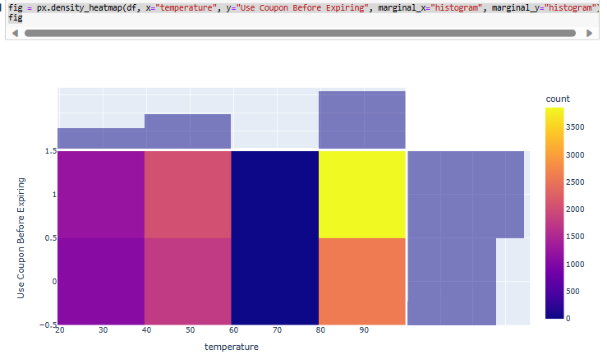
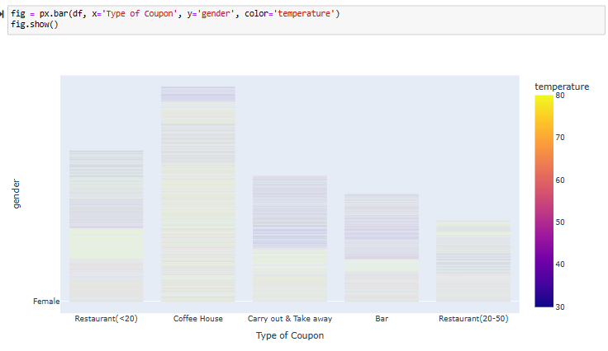
Plotting graphs – Comparing coupon Types, income, passengers, and gender who used the coupons
Types of Plots used during the exercise
Histogram/Heatmap
Bar
Violin
A Few Examples Below

Slide 7
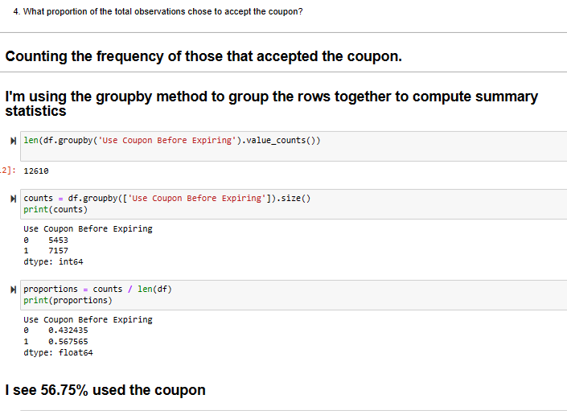
Statical summaries customers who did and did not accept the coupons
I looked at the Use Coupons Before Expiring Column and based on the functions used, I determined 56.75% of the population used the coupons.
0 – Did Not Use the Coupon
1 – Used the Coupon
A more detailed analysis of gender, age, income on who used the coupons and what type of coupons used is shown in the “Hovermill_Module 5” Juypter Notebook

Slide 8

Thank You
Annissa Hovermill

